Slide 1
Dream IPL Team
Insights

Slide 2
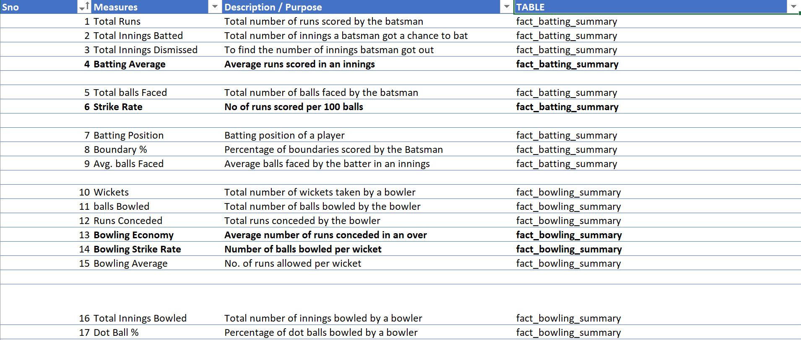
Noted few KPI’s for bowlers as well as batsmen which would help evaluate performance of players.

Slide 3
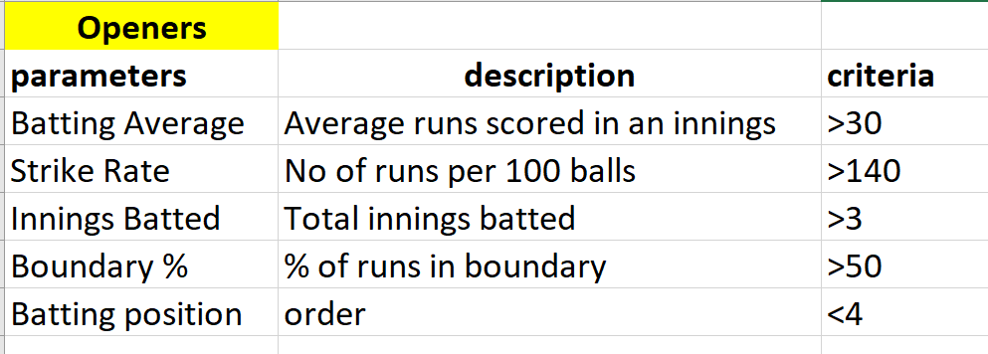
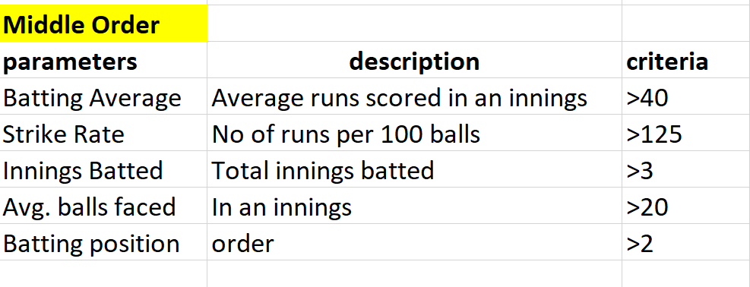
Parameters selected as Filters for different criteria of players
Openers- These are the power hitters. Mandated to provide a good start. Boundary percentage is an important
Indicator for openers as during powerplays boundaries are important. A filter of >50% of runs from boundary has
been set as a filter. Batting position is set lower than 4. 2 players in this position.
Middle order – These are anchor player which hold the innings together. Hence boundary % is not a very relevant
Criteria. Strike Rate can be lower than openers but avg. no of balls faced and batting average should be be
adequate to ensure good partnership in middle overs. 3 players in this position.

Slide 4
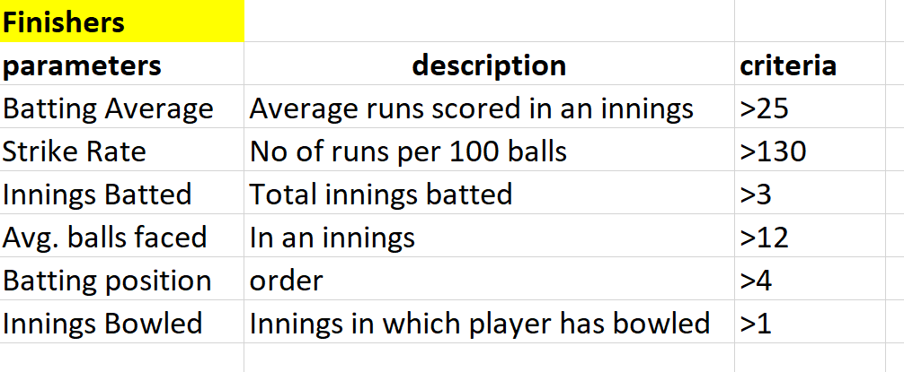
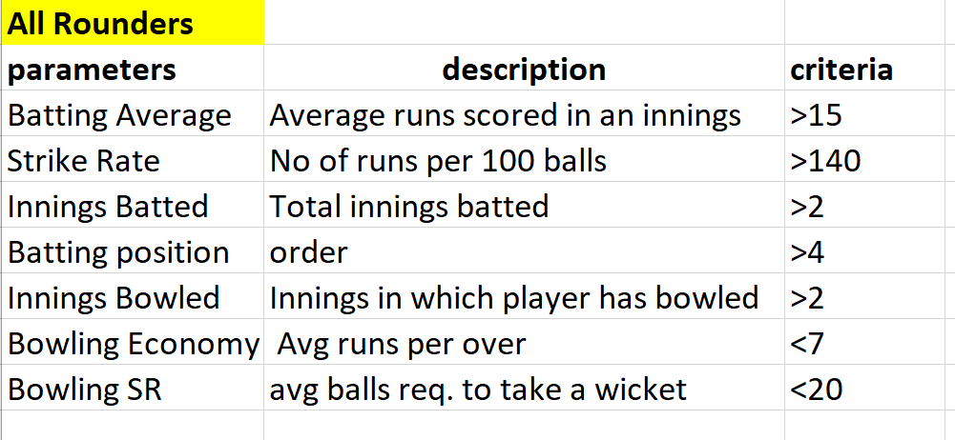
Finisher/ hard hitter – 1 player for this position. Should be able to score at a high strike rate at the same time
if the middle order fails, should be able to stabilize the innings. Hence, number of balls faced and batting average
Are also considered as key parameters. This player is more of a batting all rounder with capability to bowl when req.
All Rounders – Spinners who can bat aggressively with a good strike rate as they may end the innings. Batting average should be atleast 15. 2 players for this position. Bowling economy is targeted at less than 7 and should be able to pick wickets on av average every 20 balls. If they ball 20 overs, it can be expected they would take atleast 6 wickets.

Slide 5
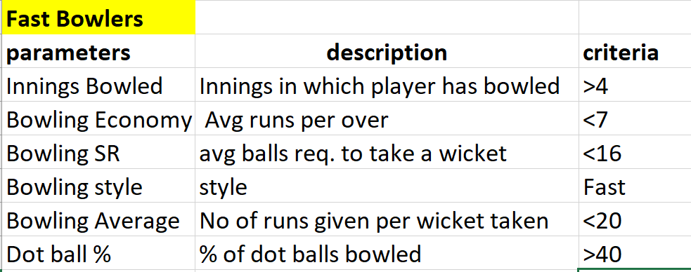
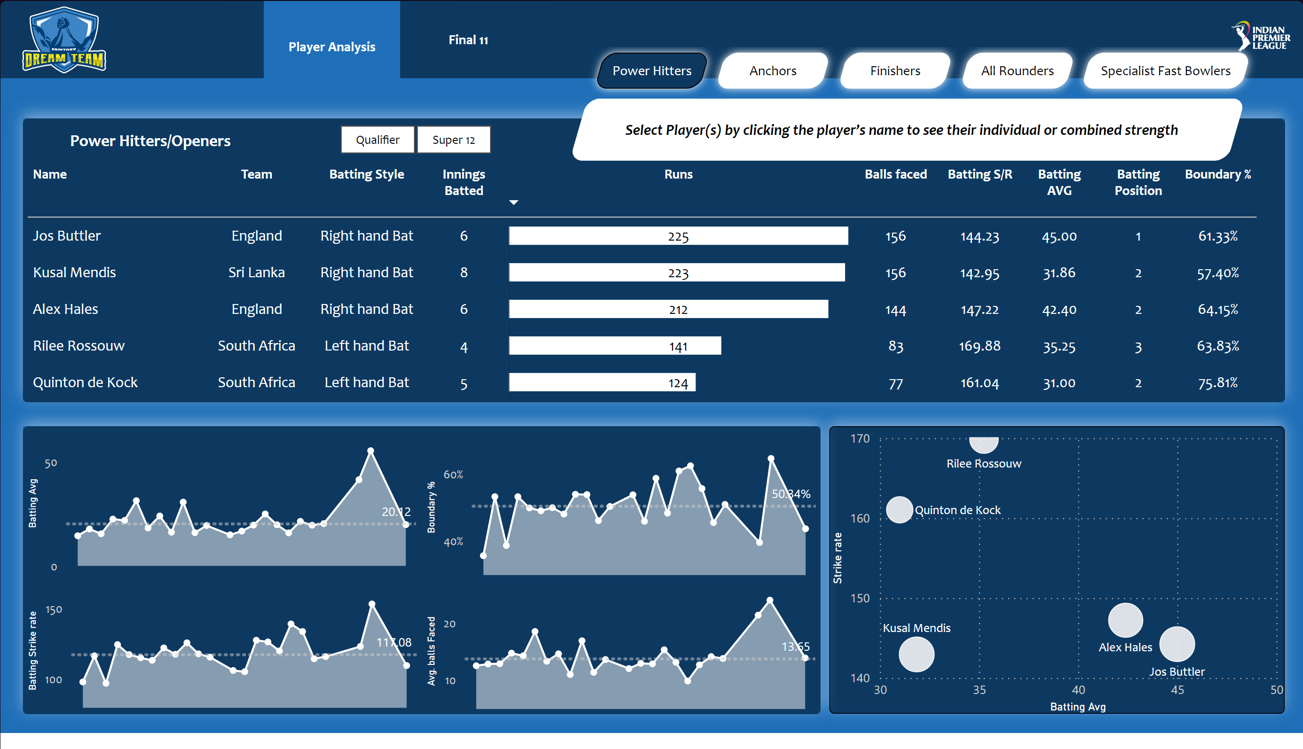
Runs expected to be conceded- max. 140 in 20 overs as all 5 bowlers have bowling economy less than 7.
Fast Bowlers- Pace bowlers expected to take wickets every 16 balls bowled. They would also act as breakers on opponent
Run scoring in powerplay. Hence dot balls conceded percentage >40 is set as an important filter.
Selecting best 11
Selection of openers –
Among top 5 players, looking at the
Scatter plot, Joss Buttler, Alex hales and Riley Rossouw are the
Most suited in terms of batting average and strike rate.

Slide 6
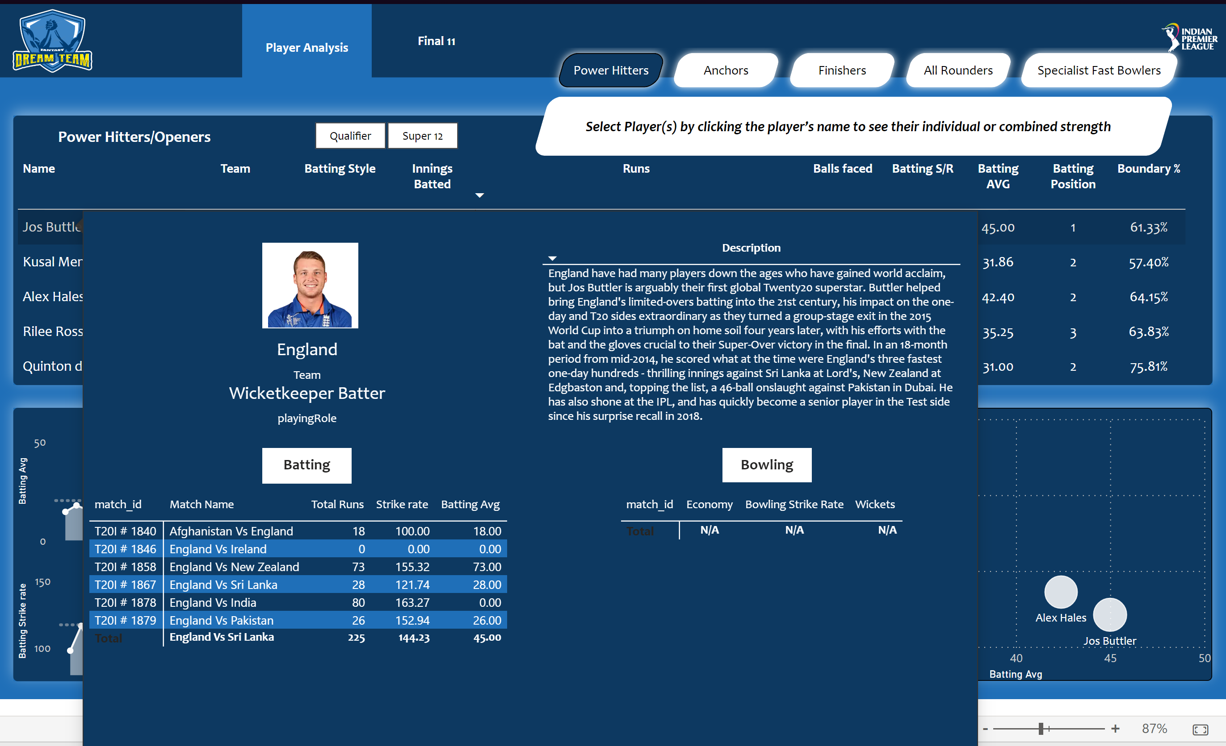
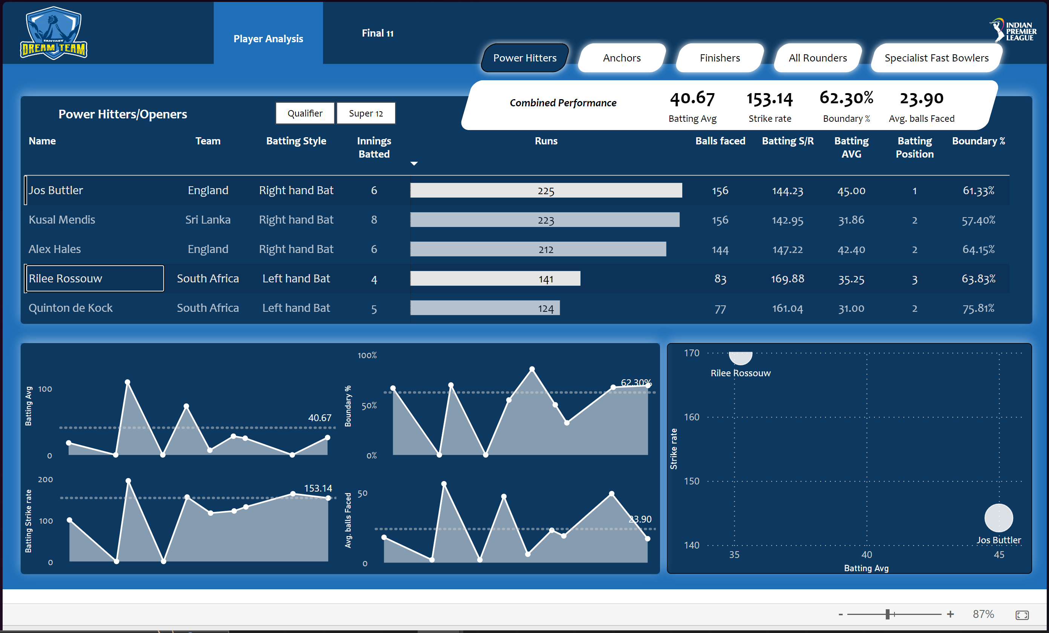
Reasons for selection of Joss Buttler:
Consistent performance
Best batting average with strike rate above
threshold of 140.
Selection of Riley R. and not Alex Hales:
For right-left combination, Riley R. is best suited
as he has the highest strike rate as seen in the plot
and would compliment Joss Buttler nicely who has
the best batting average.
Alex hales would be kept as reserve opener.
Together they give us a combined batting average of 40.67 with a
Brilliant strike rate of 153. Which means if they bat for 20 overs, we
Would reach a minimum target of 180. And on an average they would
Stay at the crease for 4 overs as the combined average balls faced is 24,
With a boundary percentage of 60%.

Slide 7
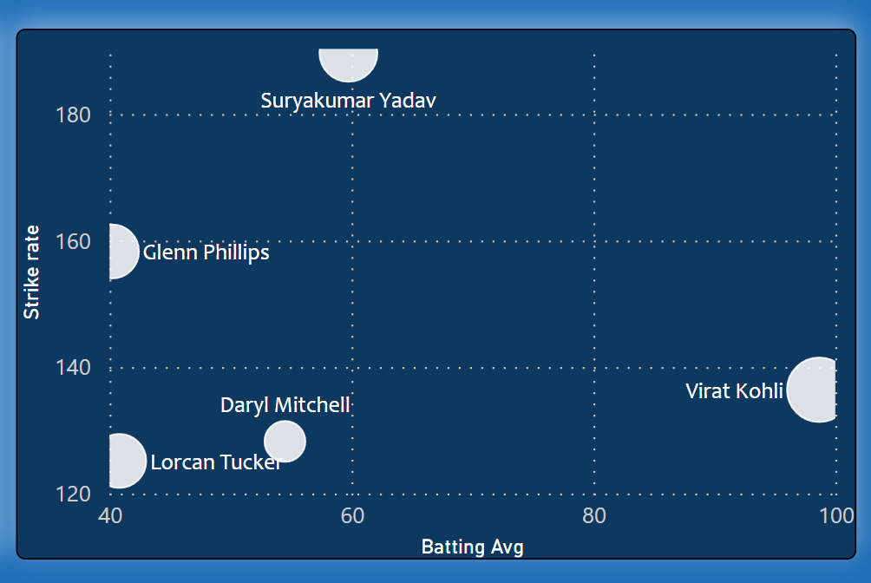
Middle order selection-
2. SK Yadav with a fantastic SR of 190 and healthy batting average stands out In the plot. He would provide a good mix with kohli having very high SR to up the game tf there is a slow start.
3. Glenn Phillips as he has batting
Average above the threshold and
Strike rate of 160 and having placed
More matches than L. Tucker
1. Virat Kohli with amazing batting average of 98 and strike rate above required 125 is a no brainer.

Slide 8
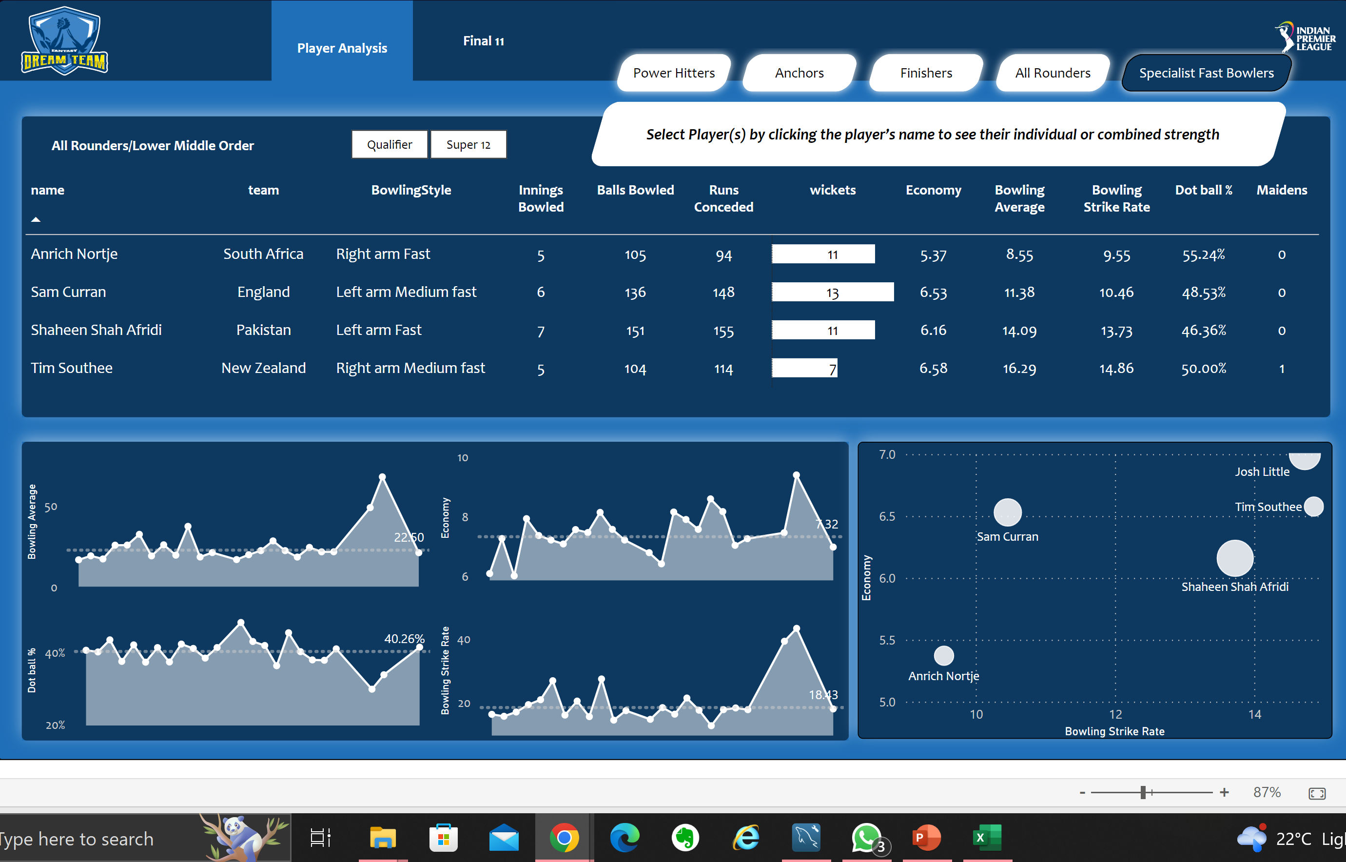
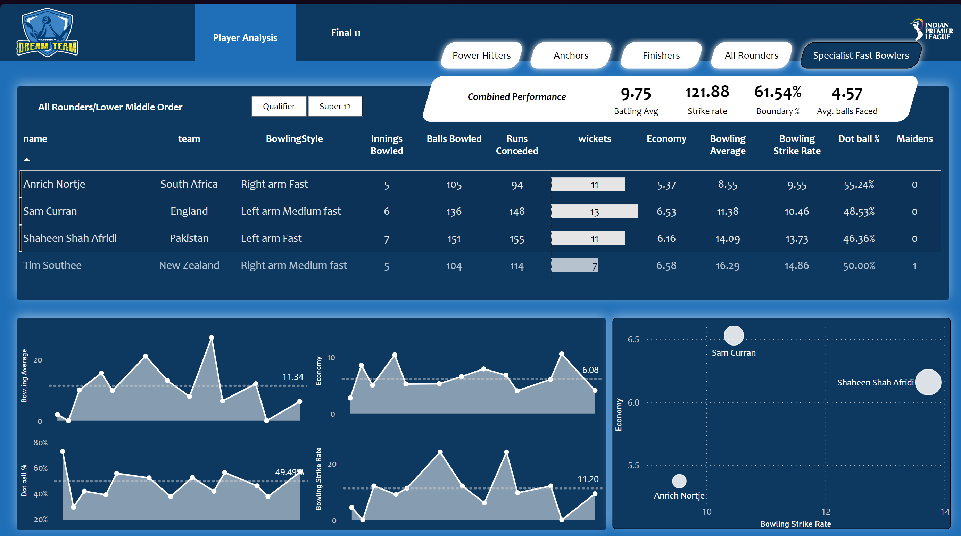
Fast Bowlers
The selection of fast bowlers would determine if we need a bowling or a batting all rounder in finisher position
And also whether spinner or fast bowler in all rounder position.
Sam Curran as his economy is around 7 and bowling average is
11.38, means he picks a wicket for every 11 runs conceded with
a healthy bowling strike rate of 10.46, means if he bowls full 4
overs he is likely to pickup 2 wickets.
Clearly, A. Nortje is the best pick being most economical and healthy
bowling SR.
3. From the plot, Shaheen S. Afridi would be the 3rd choice.
Combined Performance-
Combined bowling avg. of 11.34 which means if these 3 bowl all
20 overs, they’ll concede 113 runs. They would pick a wicket every
11 balls meaning opponent will be all out if they bowl all 20 overs.
Combined economy of 6 meaning if they would concede 36 runs in
Powerplay.
Combined dot balls percentage of around 50%.

Slide 9
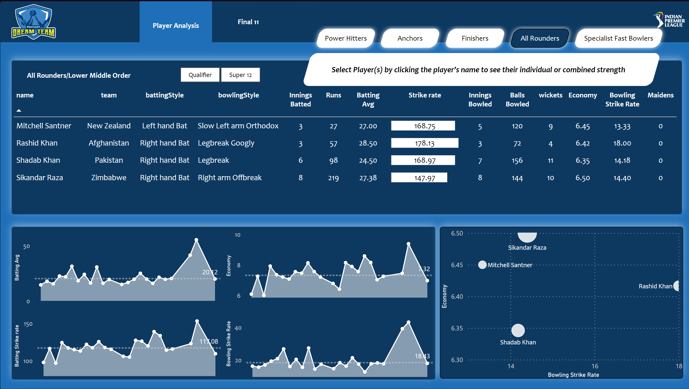
All-rounders
Since we have 3 good fast bowlers, we would like to have spinners
In all rounders at the same time with the capability to bat as well
With a high strike rate. Greater than 140.
Shadab Khan deserves a spot as he is in the best quadrant and has been
Consistent. But we would like a have a better batsman at number 7 in
Case no. 6(finisher) fails. So we would put him at number 8.
Considering the importance of batting for number 7, Sikander Raza is the
Best choice, as he has scored the highest runs and has good bowling SR.

Slide 10
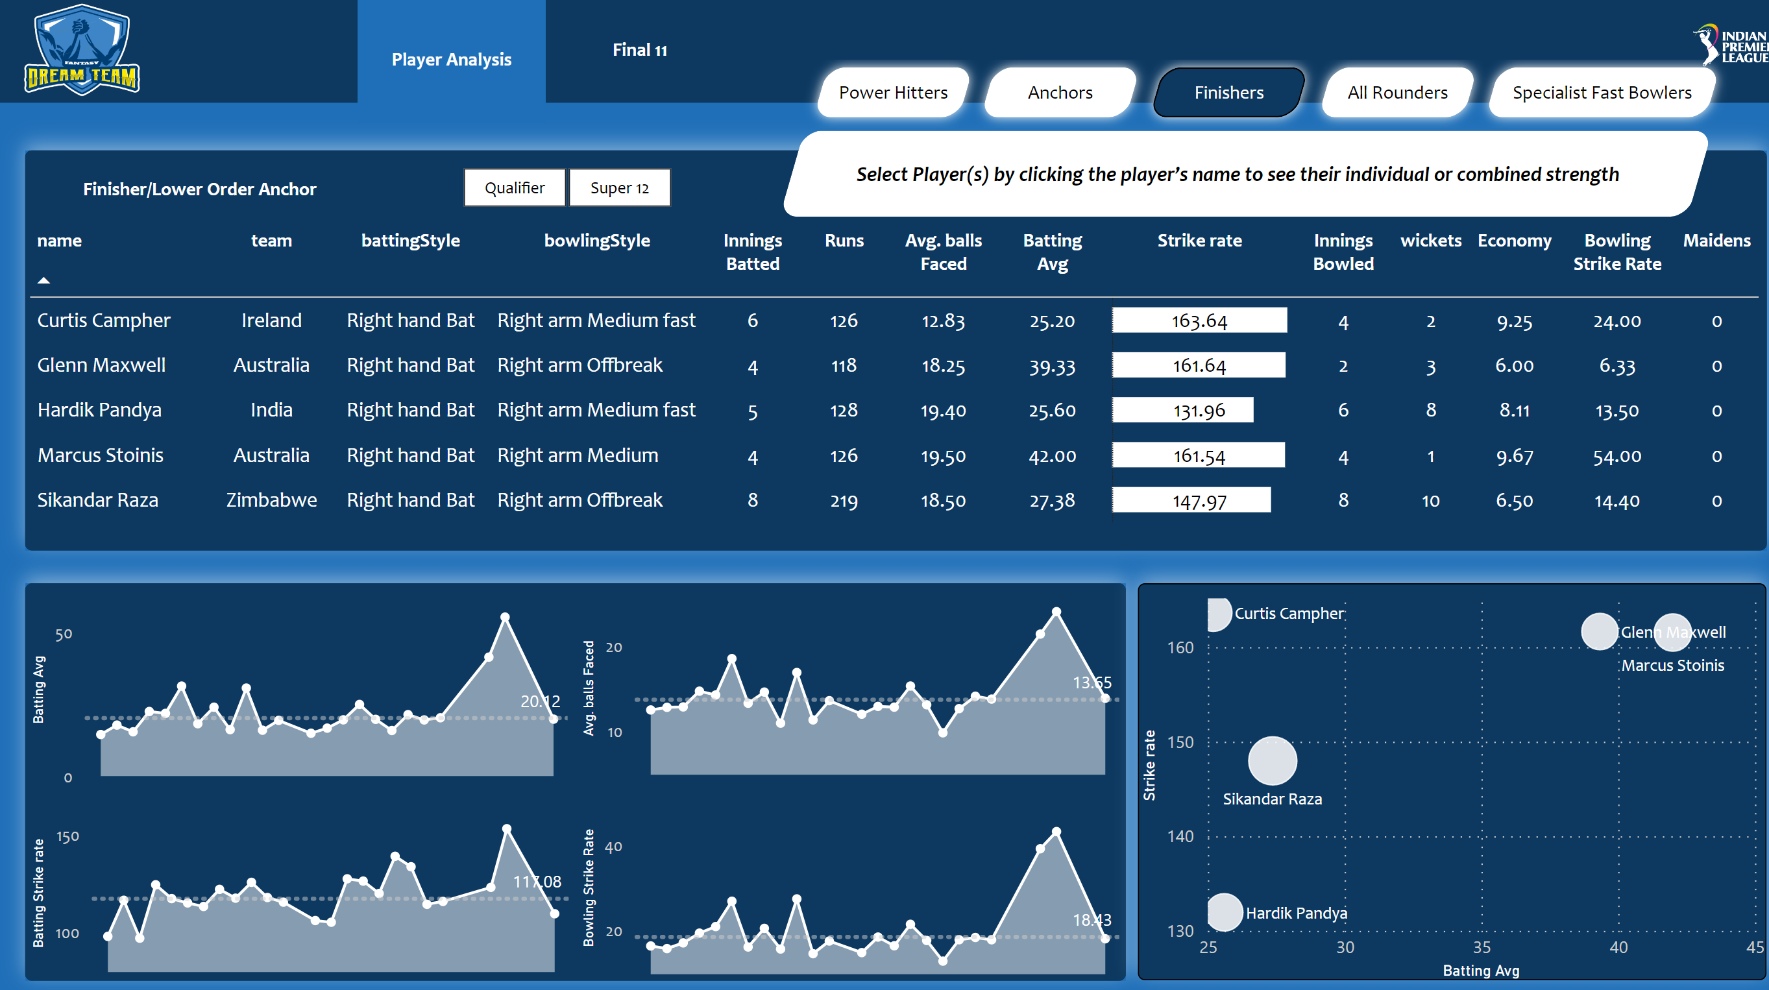
Finishers
Has multiple options. Need to pick a batting all-rounder for this position. Should have a high strike rate and can anchor
The innings when required. Ben stokes could not make it to the list as he has low batting SR. So cant include him as
Finisher would require a higher SR
We have selected 3 fast bowlers and 2 spinners. Maxwell would
Have been a good option but he is also a spinner.
We would select M. Stoinis, even though maxwell has better
Bowling economy and bowling average because he has better
Batting SR and batting average than maxwell and a fast bowler
Would be better suited for number 6 position. He can also be
Trusted to anchor the game when needed.
Hardik Pandya could be a backup in this position if a better
Bowler is required say if a pace bowler gets injured as he has
better bowling stats than Stoinis.

